Slide 1
Digital control devices
KON-C2004 Mechatronics Basics
Raine Viitala 26.11.2024

Slide 2
Overview
Real-time computing
Programmable logic controllers (PLC)
Other computing devices
Digital communication

Slide 3
Mechatronic machine - subsystems
Controlling
computer
User Interface
Sensors
Signal
processing
Communication
(Bus, IoT, 5G)
Actuators
Controller
Affect and sense the physical world
Other systems and machines

Slide 4
Real-time computing

Slide 5
Real-time
Guaranteed response in specified time frame
Hard realtime
Delayed result leads to system failure
Firm
Delayed result is useless but some delays are tolerated
Soft realtime
Delay reduces the usefulness of the result
Notes:
Does not necessary mean high performance system. The deadlines can be seconds or minutes, although usually they are milliseconds or microseconds.

Slide 6

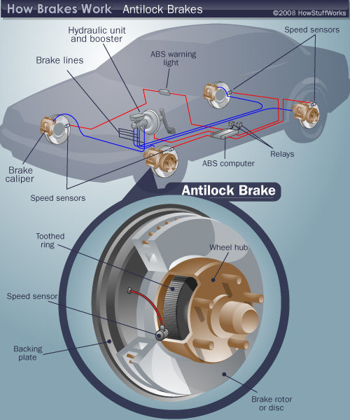

Hard real time
Safety critical functions
Anti-lock braking etc.
Fly-by-wire
Notes:
Hard real-time: car engine. Control failure may cause engine failure. Life critical systems.
Hard real-time: safety devices and for example heart pacemakers. Control failure may cause casualties.

Slide 7
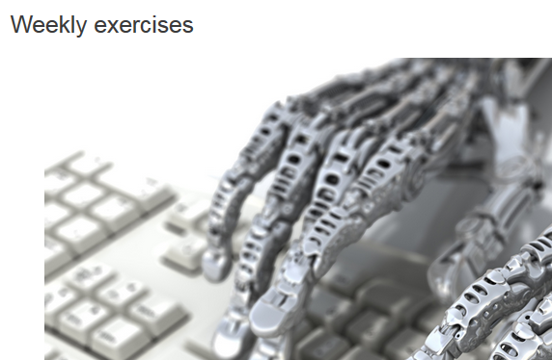
Firm real time
Control algorithms
Performance and stability
Notes:
Firm real-time: course exercises. Exceeding DL means zero points but doesn’t result in course failure.

Slide 8
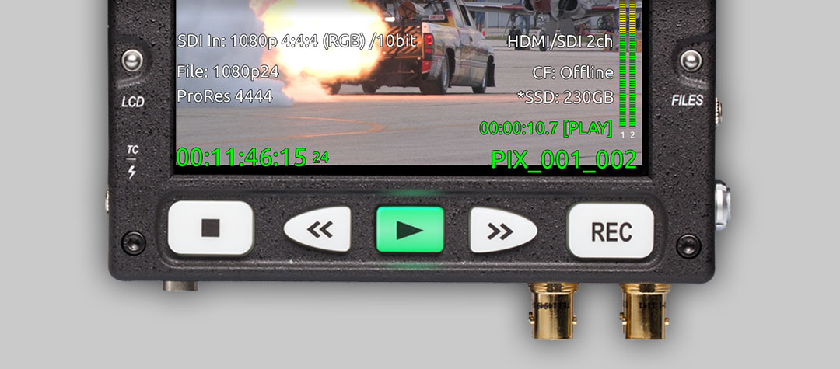
Soft real-time
Video playback, audio synthesizer
Notes:
Soft real-time: live video playback. Delays may cause artefacts or distortion but playback recovers after them.

Slide 9
Real time ≠ high performance

Slide 10
Control system point of view
Control algorithm often relies on constant update interval
Too long delay -> unstable system
- remember exercise!
Sampling rate
Time between two updates of the control signal
Delay
Time from input sampling to output
Notes:
Important especially in very high dynamic systems like electric power converters where the time constants can be in the order of microseconds.
For example the discrete PI controller algorithm integrate faster if the calculating frequency is faster. Faster frequency requires lower gain. Or using the continuous version of the algorithm (analog signal processing).

Slide 11
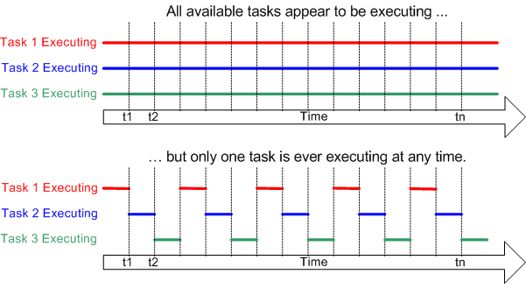
Microcontroller real-time operation
Interrupt based scheduling
Possible tasks
Reading sensor input
Control algorithm
User interface
Bus communication
Notes:
Computer mouse movement on screen. Appears to be continuous, but in reality updated position is drawn at a constant interval. Screen refreshment rate etc. Human can hardly detect the difference.
Real time scheduler pretty easy to implement by yourself. Allocate a certain time frame for each task during one exection cycle.
For example the execution time of iterative algorithms can vary a lot. Threfore, they should be avoided.
http://www.freertos.org/implementation/a00005.html

Slide 12
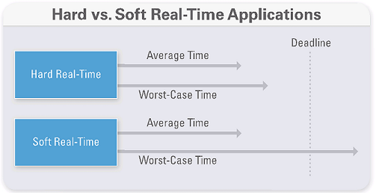
Real-time operating system
Definition: “A real-time behavior of a software system requires that each process or task execution must satisfy bounded response-time constraints or risk severe consequences, including failure.”
http://www.ni.com/white-paper/14238/en/
Notes:
Deterministic response.

Slide 13
Real-time operating systems
FreeRTOS
Microcontrollers
Real-Time Linux
Simulink Real-Time with Speedgoat RT target computer and Labview Real-Time
Measurement and prototyping on PCs and FPGAs
“Standard” Windows with real-time kernel extension (RTX)

Slide 14
PLCs Programmable Logic Controllers

Slide 15
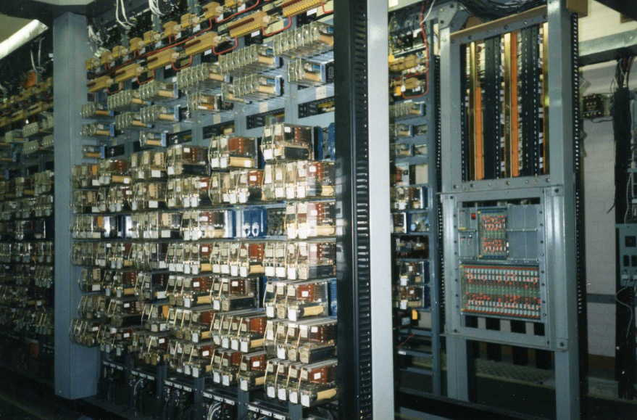
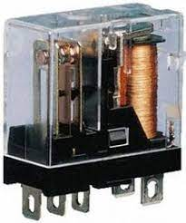
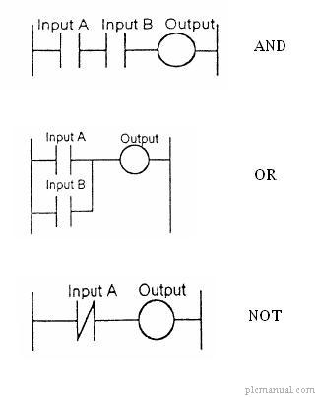
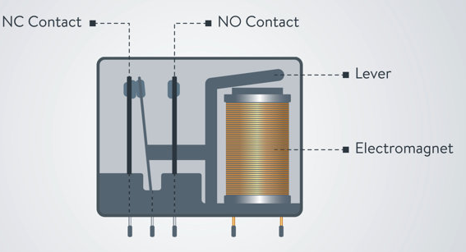
The traditional logic controller: Electromechanical relays
Still used for example in railway interlocking systems
Robust, long lifespan
Expensive special relays
Notes:
Relay based control systems are still widely used for example to control railways.
Expensive special relays because of safety.
Are quite robust, lifespan can be over 50 years.
Tolerate high voltages and rough environmental conditions.
Rewiring laborious, installation error, component failures.
Also cams, drum sequencers etc.
Because relay systems were large and difficult to reconfigure, car manufacturing industry developed PLC in early 1970s.
http://www2.liikennevirasto.fi/julkaisut/pdf3/lop_2013-05_releiden_kaytto_web.pdf

Slide 16
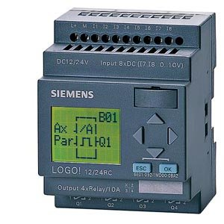
The better way: Programmable Logic Controller (PLC)
Resistant to
Electromagnetic interference
Dust, vibration, heat resistant
Modular
Off-the-shelf
Easy and simple to set up
In comparison to a microcontroller system
DIN rail mounting
Higher voltage, better protected IO
http://i01.i.aliimg.com/img/pb/629/105/478/478105629_223.jpg
Notes:
The most important differences between any computer and a PLC are ruggedness and availability of IO. Normal desktop computers do not have any general purpose io.
Support available from the manufacturer after the system designer leaves the company. For a self built microcontroller system support disappears with the designer.
Have been used for nearly 50 years.
Embedded processor with some type of real time operating system.
Modular IO or remote IO
Need to be very reliable and rugged, therefore not always the newest technology is used.
This has many benefits • Programming is easier to replicate • It is easy to change • Less components • Cheaper

Slide 17
PLC vs microcontroller
PLC
Encased – protected from environment
IO is protected? – from high voltage, outputs more current – does not break the whole device – often based on relays
Modular – add more io
Programmed with IEC 61131-3 languages – doable by an electrician
Easily replaceable
Expensive (not very)
Microcontroller
Unprotected prototyping board
For example 0-5 V low current I/O
Programmed with low level language, for example C
Extensions with communication bus and additional code
Very cheap
Notes:
In reality you need both • A microcontroller controls the specific actuator • PLC monitors the whole system
In practice
Microcontroller: Single device control
PLC: Single machine control
PC: Single factory/manufacturing unit control

Slide 18
PLC vs PC
PLC
Program once, run forever
Dedicated system
Cheaper
Programmable by electrician
Limited user interface (buttons, maybe a screen)
Built-in inputs
PC
Lots of computing power
Often regular software updates
Display, flexible UI
Inputs with extension cards
Notes:
In practice you want both • PLC routes and monitors your signals • Your PC makes the front end and assists in programming

Slide 19
PLC programming
Programmed typically with a PC (Ethernet, serial bus etc.)
Programming languages: IEC 61131-3
Ladder diagram (LD), graphical
Function block diagram (FBD), graphical
Structured text (ST), textual
Instruction list (IL), textual
Sequential function chart (SFC), has elements to organize programs for sequential and parallel control processing.
Notes:
Apparently ladder diagrams are still widely used at least in America.

Slide 20
Ladder diagram
Similar to relay schematics
Understandable to electricians without any programming skills
By far the most used PLC language
Also operators for
Mathematical operators
Analog operators
Timer operators etc.
http://www.plcmanual.com/plc-programming
Notes:
One path = rung
Diagram is executed left to right and up to down in a loop.
In real world applications, there may be hundreds or thousands of rungs
Analog quantities and arithmetical operations are difficult to express in ladder logic.
There is usually limited support for arrays and loops (loop inside a rung?)

Slide 21
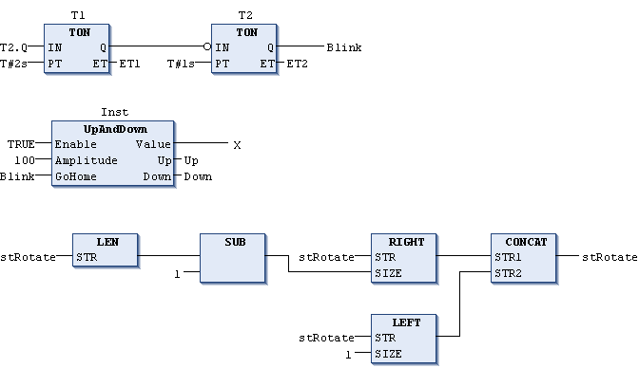
Function block diagram
http://infosys.beckhoff.com/english.php?content=../content/1033/tc3_plc_intro/html/Function_Block_Diagram_FBD.htm&id=
Notes:
Used a lot in process control automation.
Functions such as timers, counters, logical functions, sweeps, application specific blocks.

Slide 22
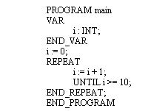
Structured text
A bit like C or Pascal
Familiar expressions
If, while, for, function calls
http://www.thelearningpit.com/hj/plcs18.asp

Slide 23
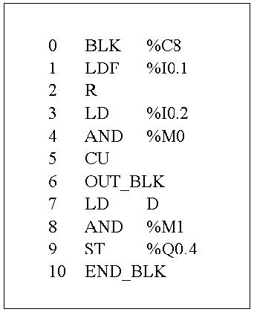
Instruction list
A bit like Assembly
http://4.bp.blogspot.com/-V67KQWGCQC4/T30JnZx7saI/AAAAAAAAAcM/BygizcA-ASI/s1600/untitled.JPG
Notes:
All the other languages can be translated to instruction list but not the other way around.
Sequential function chart.

Slide 24
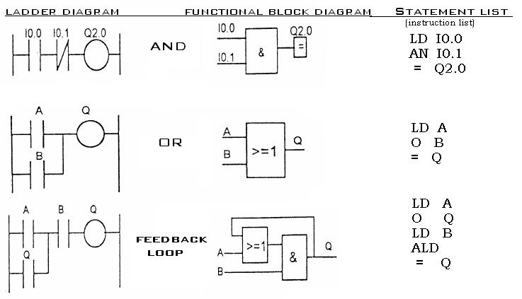
Ladder vs FBD vs IL
http://www.plcmanual.com/plc-programming

Slide 25
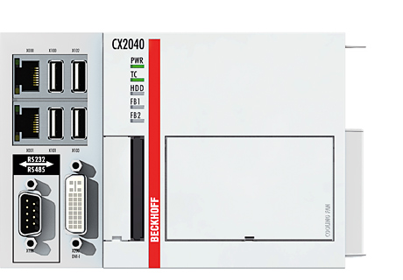
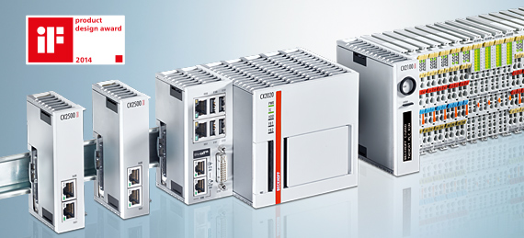
Soft PLC
Example: Beckhoff industrial PCs
http://beckhoff.com/
Notes:
Can run other programs simultaneously. TwinCAT from Beckhoff promises less than 15 microsecond jitter with their real-time kernel.
Standard Ethernet, USB and display connectors. Cfast memory slot. Optional Serial/CAN/Profibus interface.
DIN rail moun, modular IO
Machine vision etc. possible.
A PAC (programmable automation controller) is generally recognized as a hardened modular industrial controller that uses a PC-based processor and allows programming options beyond the IEC 61131-3 languages. Industrial PC or IPC is another term often used interchangeably with PAC

Slide 26
Other computing devices

Slide 27
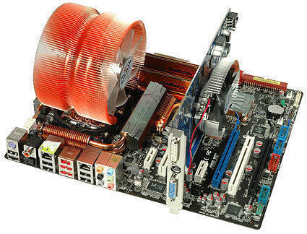
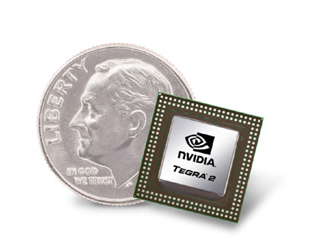
System on a chip (SoC)
http://www.ubergizmo.com/what-is/system-on-a-chip/
All components of a computer on one chip
Microprocessor
Memories
Peripherals
Graphics and audio prosessors
Wireless transmitters
Battery management
Relatively low energy consumption
Used in cell phones and tablets
Notes:
Similar to a microcontroller but more powerful. Faster processor, more memory, graphics processing, more advanced communication i.e. Ethernet, Wifi.
Run desktop operating systems such as Windows or Linux.

Slide 28
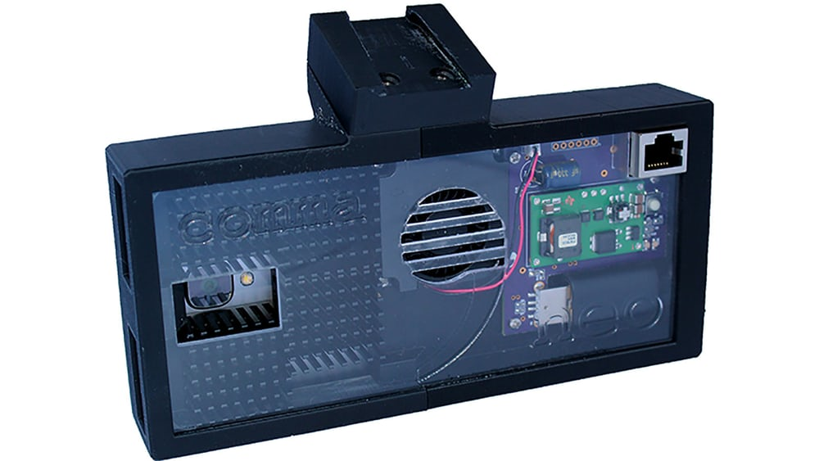
Example: Neo research platform for autonomous driving
Affordable hardware
Oneplus 3 cell phone
Powerful SoC
Camera
GPS
CAN bus communication with car
Open source software
Stripped Android
Neural network
Notes:
Supposedly similar functionality as Tesla Autopilot. Adaptive cruise control and Lane keeping assist.
Compatible with a new Honda Civic and couple of other models.
Neural network initially needs training.

Slide 29
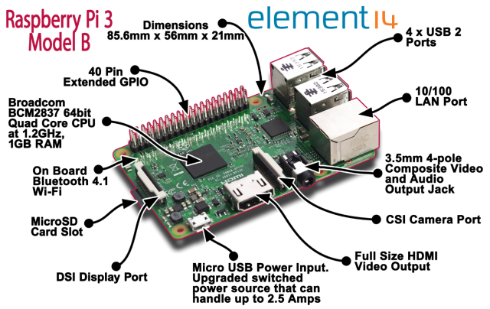
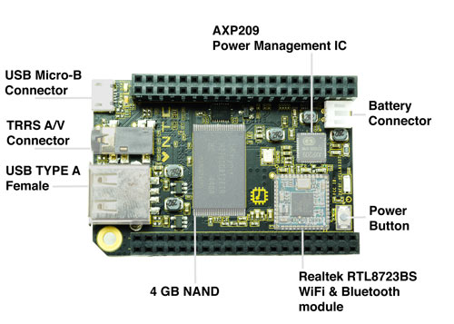
Single board computers
Raspberry Pi 3 – 35 $
Broadcom BCM2837 SoC with 1.2 GHz processor, 1 GB RAM
GPU, HDMI out
Ethernet, Bluetooth, GPIO, MicroSD
CHIP – 9 $
1 GHz Allwinner R8 SoC, 512 MB RAM
USB, composite video, Wifi, Bluetooth, GPIO
4 GB onboard flash memory
Battery management
Notes:
A couple of examples. Utilize SoCs. Both run Linux.
HDMI and VGA video out for CHIP with additional components.
https://getchip.com/pages/chip

Slide 30
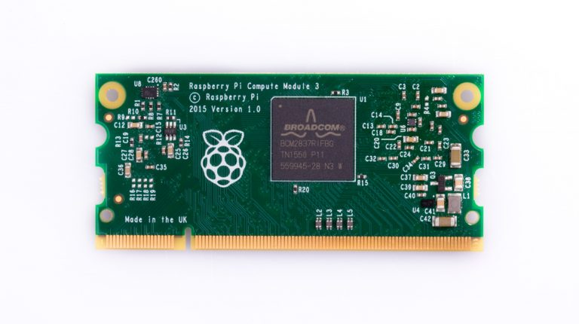
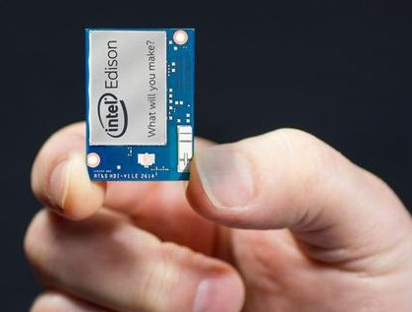
Computing modules
Raspberry Pi 3 - 30 $
Same SoC as in Raspberry Pi 3
1,2 GHz, 1GB RAM
4 GB flash memory
SODIMM connector
Intel Edison – 50 $
500 MHz Atom, 512 MB RAM
Integrated microcontroller
4 GB flash
Wifi, Bluetooth, 40 GPIO
Linux, Arduino, C/C++, Python…
Notes:
Meant to be embedded in a system. External board required for connectors. Video output usually not available.
Edison works directly from single lipo cell. Integrated microcontroller can be used for running for example a real time operating system independent from the Linux running on the Atom CPU.
Lower processor speed means usually less power consumption.

Slide 31
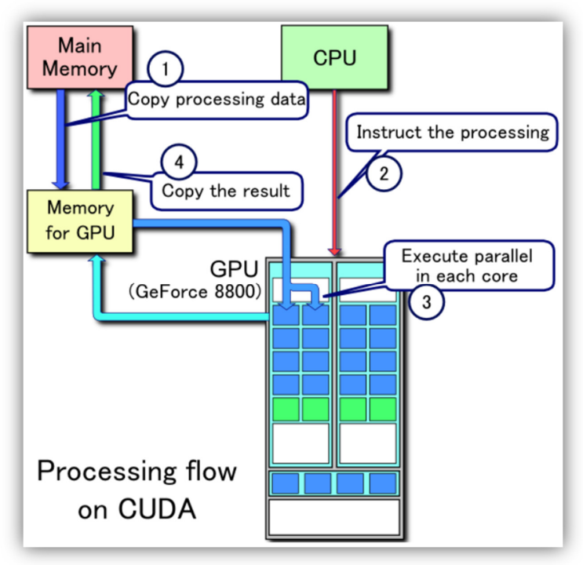
Graphics processors
CPU – a 1-8 cores, GPU – thousands of cores
Efficient parallel processing
Non-regressive simulations, machine learning, neural networks
Fast floating point value calculations
Signal and image processing
http://www.rugged.com/sites/default/files/High%20Perfomance%20GPGPU%20for%20Embedded%20Systems.pdf
Notes:
Not everything can be processed in parallel.
Image processing – object recognition in autonomous driving, radar data processing etc.
Model based controllers.

Slide 32
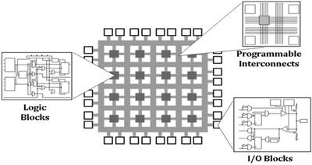
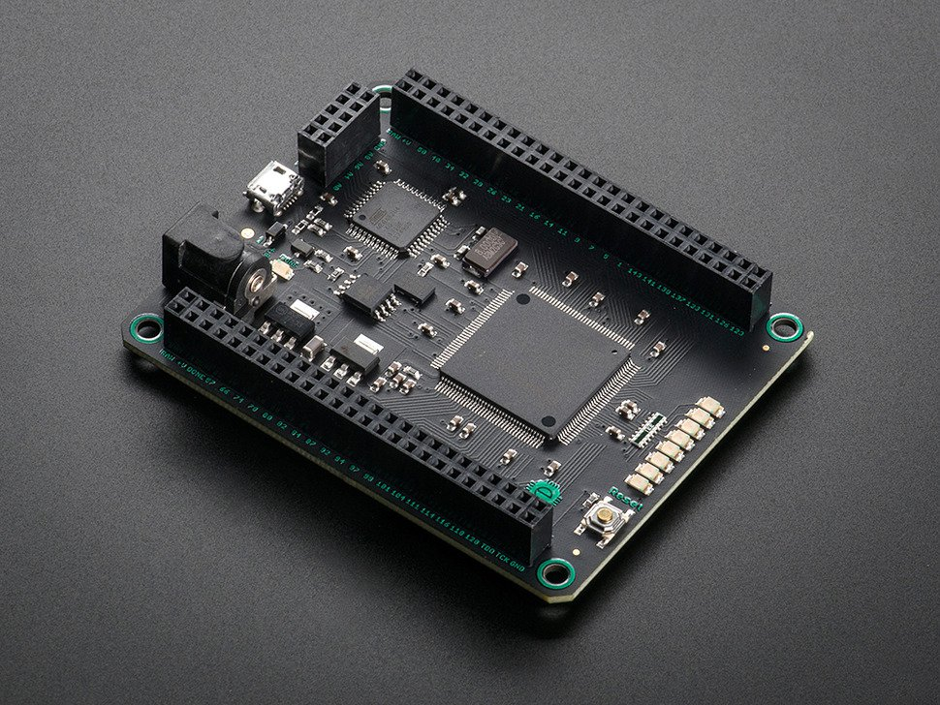
FPGA – field programmable gate array
http://www.ni.com/tutorial/6097/en/
Hardware implementation, no software
Programmatically reconfigurable logic circuit
Parallel processing
Very fast response time (<µs)
High performance per watt
Hardware Description Language
https://www.adafruit.com/products/1553
Notes:
No operating system etc.
Very deterministic response. No jitter caused by software scheduler etc.
Mojo FPGA development board 75 $.

Slide 33
Digital communication

Slide 34
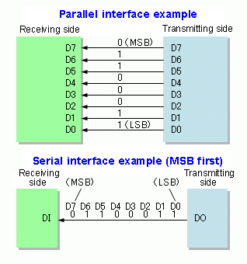
Parallel vs serial communication
Parallel
Bits transmitted simultaneously in parallel wires
Serial
Bits sequentially in the same line
http://en.wikipedia.org/wiki/Parallel_communication
Notes:
In theory parallel communication is faster since more lines are used.
In parallel communication, crosstalk creates interference between the parallel lines, and the effect worsens with the length of the communication link. Crosstalk is caused by capacitive and inductive coupling.
Serial signal is internally always converted to parallel data. Universal asynchronous receiver/transmitter (UART) converts the data.
Parallel communication has become obsolete after IC technology has made serial – parallel conversion easier and high speed serial buses have been introduced.
Chip internal buses are still parallel. Memory bus etc.
Hard disk IDE cable vs SATA. Printer port and serial port vs USB.
Serial communication requires simpler cables and less pins in the ICs which makes the chips and the cables cheaper.

Slide 35
Serial and parallel buses
Serial
USB (Universal Serial Bus)
Ethernet
PCI-e, SATA
RS-232
I²C, SPI
CAN, Profibus, Fieldbus foundation, AS-interface
Parallel
PCI
SCSI
IDE
Printer port
Notes:
Basically all paraller buses are obsolete except the ones used inside or between integrated circuits, for example between a microprocessor and an external memory.

Slide 36
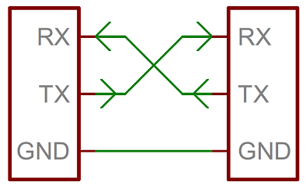
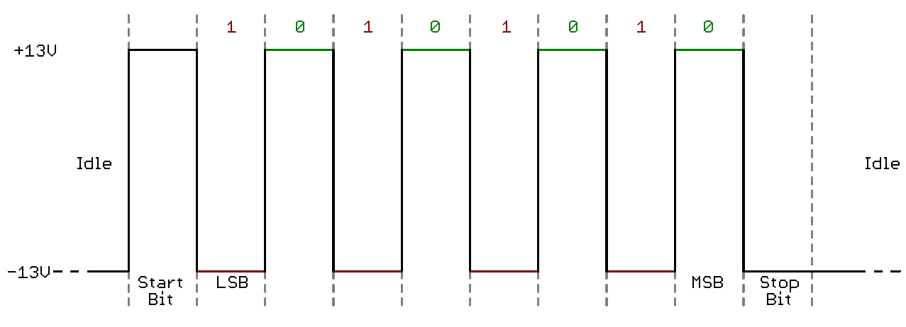
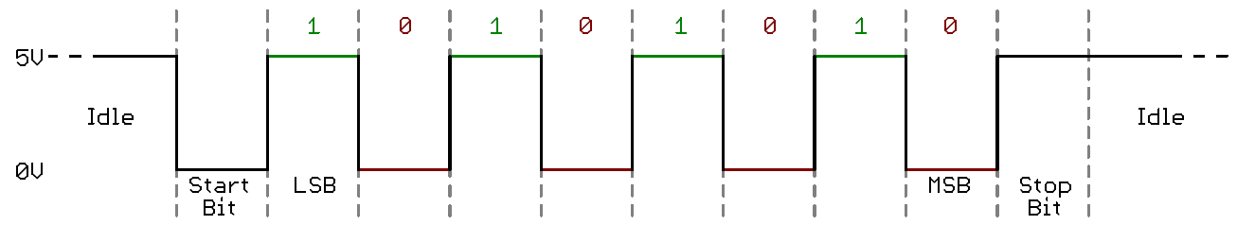
RS-232
Also known as ”Serial bus”
Voltage level 3-15 V
Negative = 1
Positive = 0
Also TTL (0-5 V)
< 0.5 Mbit/s
https://learn.sparkfun.com/tutorials/serial-communication
Notes:
RS-232 sets a standard for the electrical characteristics of the signal i.e. voltage levels etc. It does not define the protocol i.e. the character set or framing of the messages.
TTL = transistor – transistor logic = 0-5 V
RS-485 a differential version for longer distances and more transfer rate. The basis for several field buses (Modbus, Profibus).

Slide 37
Field buses
AS-Interface
Modbus
Foundation Fieldbus
Profibus/Profinet
Interbus
EtherCAT
Notes:
No common language between devices in the industry. Several different buses used in difference places and different areas of industry.

Slide 38
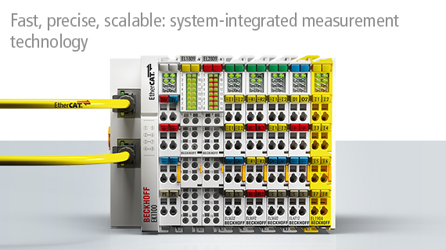
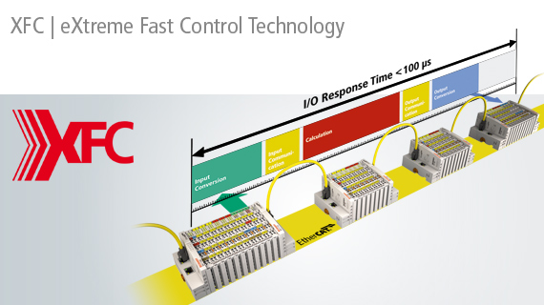
Example: EtherCAT bus
http://beckhoff.com/
Notes:
Because the terminals have ASIC chips for communication and separate processors, they can process data at the same time as they communicate.
They can also make multiple measurements and transmit them as an array.
100 us = 10 kHz

Slide 39
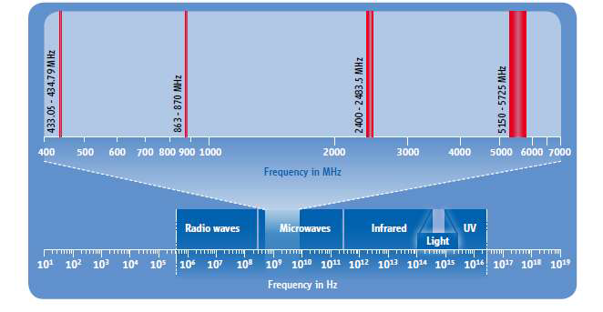
Industrial wireless communication
”Generic RF”
<1 GHz
Bluetooth
2,4-2,5 GHz
Wifi
2,4-5 GHz
IEEE 802.15.4
2,4 GHz
Wireless HART Zigbee, ISA100.11a
5G
RFID
http://www.iestcfa.org/presentations/sies11/keynote_Svensson.pdf
Notes:
Wireless is never as robust as a wired connection. Mainly used for monitoring but also possible to create fast feedback loops.
Saves cabling and installation costs. Saves space.
Modifications to systems are more flexible.
Possible to transmit data from moving parts like car tires, or transmit through vacuum seals etc.
802.15.4 usually offers mesh networking.
Several competing standards slow down the wider use of wireless communication.
RFID zero power sensors.
Larger transmitting power and higher transmitting frequency mean more power usage. Can be difficult with batteries.

Slide 40
Summary
Real-time computing is required for most control systems
Microcontrollers are for embedded systems and hobby stuff
PLC is the multipurpose logic tool of industry
Robust, simple
There is no universal digital communication standard in the industry, instead several competing standards
What is the future of wireless industrial communication?

Slide 41
Mechatronic machine - subsystems
Controlling
computer
User Interface
Sensors
Signal
processing
Communication
(Bus, IoT, 5G)
Actuators
Controller
Affect and sense the physical world
Other systems and machines

Slide 42
Exam 12.12.2024 12.00-16.00
The exam is arranged locally
Exam tasks will be published in MyCourses – very similar to exercises.
All material can be used, except generative AI.
MyCourses exam page “Exam 12.12.2024” will have detailed instructions. Please read them before the exam starts.
You must go to a certain computer classroom depending on the first letter of your last name
Y430, U256 or U257 (Undergraduate center) – distribution will be published in MyCo.
The gatekeeper password to open the exam tasks in MyCourses will be delivered in the computer classroom.
The password is visible, and the gatekeeper is active 12.00-13.00 -> you must join within that time.
Entering the classroom is possible before 12.00 and 12.15-13.00.
No communication allowed between the students
No chatGPT or other generative AI allowed
We will monitor the computer screens with a specified exam software in the classrooms.
The students will be monitored with exam attendants walking around in the classroom

Slide 43
The end Give feedback!
In your feedback, please consider your answers from the learning viewpoint, not the convenience.

